Slide 1
IDI – KSC Cooperation 2018 - 2019
11th Meeting of the Steering Committee of INTOSAI Committee on Knowledge Sharing and Knowledge Services
Philippines (12-14 June 2019)

Slide 2
Cooperation with Working Groups and KSC
IDI’s Performance Highlight 2018
IDI SP 2019-2023

Slide 3
Cooperation with Working Groups
Auditing Lending & Borrowing Frameworks – 24 SAIs supported, compendium published, Handbook on Auditing Public Debt Management in final stage.
WGITA – IDI Handbook on IT Audit to be revised based on surveyed SAI needs and IDI’s Quality Protocol for GPGs
IDI’s Global Programme for SAIs Fighting Corruption
SAI PMF integrated in SPMR. Rollout in INTOSAI regions initiated.
Cooperation with WGKNI for Auditing SDGS programme

Slide 4
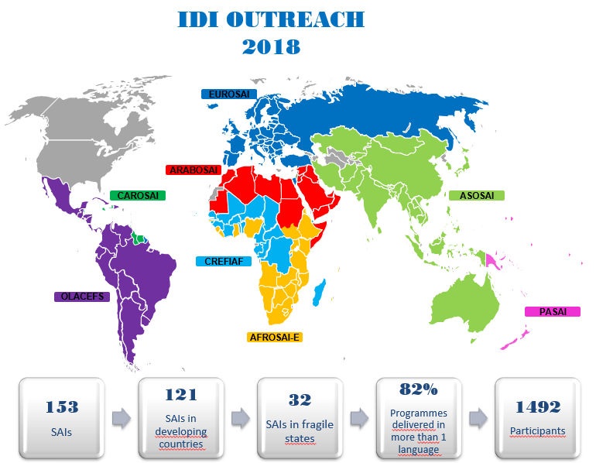
PERFORMANCE HIGHLIGHTS 2018
Effective SAI capacity development programmes and GPGs:
11 IDI Programmes delivered at different levels
IDC Secretariat hosted
91% of IDI programmes → service delivery model
SPMR pilot phase in PASAI and CAROSAI for 18 SAIs
Support to ISSAI-based FAdevelopment in 8 South East Asian countries launched
PESA pilot developed
Strategic bilateral support in 9 SAIs (PAP-APP)
2 GPGs published following protocol: FA iCAT & Implementation Handbook, others drafted for exposure

Slide 5
Performance Highlights 2018: SAI-Level Results from IDI Programmes
20 SAI Young Leaders in 16 SAIs supported New draft audit Acts submitted to Parliament in Somalia & Gabon | 40 EN SAIs developed & approved stakeholder engagement strategies & action plans, 21 being finalized 15 SAIs in CREFIAF submitted draft stakeholder engagement strategies & action plans to IDI | 50 SAIs completed SAI PMF assessments (10 published, 2 repeat assessments) 18 SAIs completed audits of the institutional framework for fighting corruption and submitted to relevant authorities
40 SAIs completed audits of national preparedness for implementation of SDGs 11 SAIs & one sub national audit office completed audits of preparedness for implementation of SDG5 | 7 SAIs in AFROSAI-E FA of Externally Aided projects in Agriculture & Food Security are ISSAIs compliant SAI-level support: SAI Bhutan → 6 pilot ISSAI-based audits submitted to authorities, SAI Tonga → ISSAI-based FA, CA, PA | Long-term holistic support to SAI Somalia → conduct of FA and CA Life-line support to SAI South Sudan → 2 PA reports drafted Status and needs reports completed for three SAIs in challenged situations, and underway in four more

Slide 7
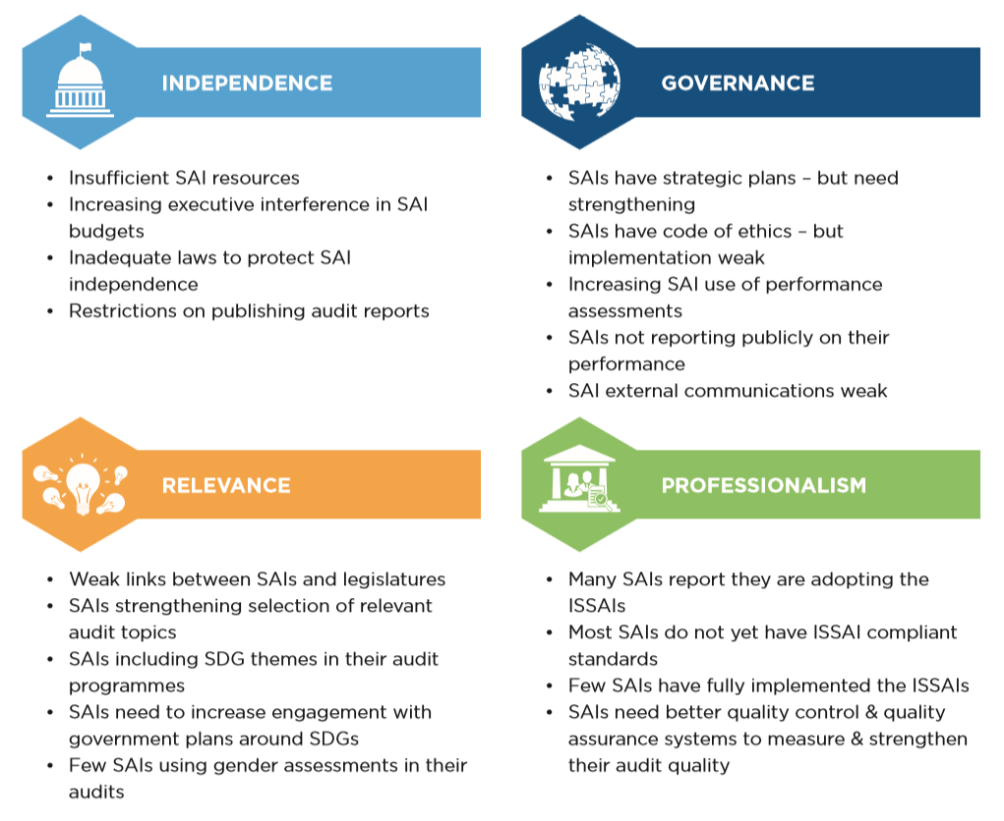
Global State of SAI Capacity and Performance (2017)

Slide 8
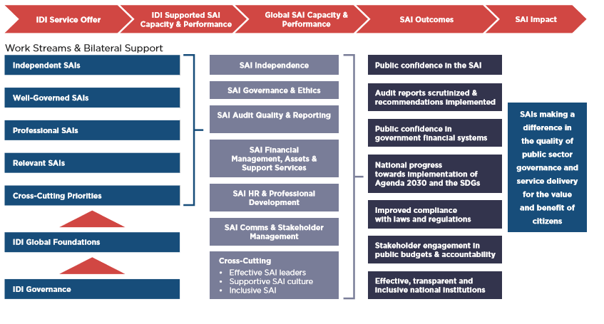
IDI’s Strategic Priorities

Slide 9
Strategic Shift
Integration of the Gender Perspective

Slide 10
Implications
Growth
Balancing the roles of enabler and provider of support
Strategic Partnership
Targeting of SAI-level support
Leaving No SAI behind
Ensuring resources are effectively targeted

Slide 11
To read more about IDI Performance 2018 and IDI Strategic Plan, please use the following links:
IDI Performance and Accountability Report (PAR) and its appendix 2018 at http://www.idi.no/en/about-idi/reports
IDI Strategic Plan 2019 – 2023 at
http://www.idi.no/en/about-idi/strategies-and-plans

Slide 12
THANK YOU

